Slide 1
Final Design Presentation: Engineering Services for Watershed Improvement
Beaver Professional Services: faith gillen, will mockert, Caroline Skotarzak
PREPARED FOR:

Slide 2
BPS Team Introduction
Will Mockert – Hydrologic Engineer
Caroline Skotarzak – Project Manager and Geological Engineer
Faith Gillen – Surveying and Geospatial Engineer

Slide 3
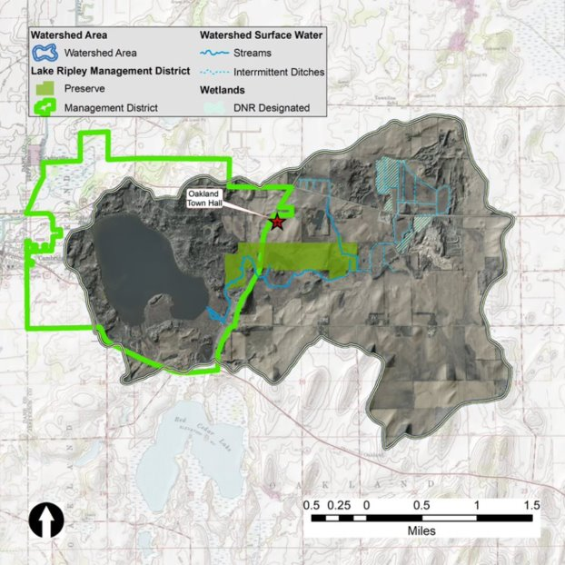
Project Background
Client: Lake Ripley Management District (LRMD)
Project Goal: Improve Lake Ripley Water Quality
Project Site: LRMD Preserve
Project Scope: Manipulate tributary stream to achieve water quality goals

Slide 4
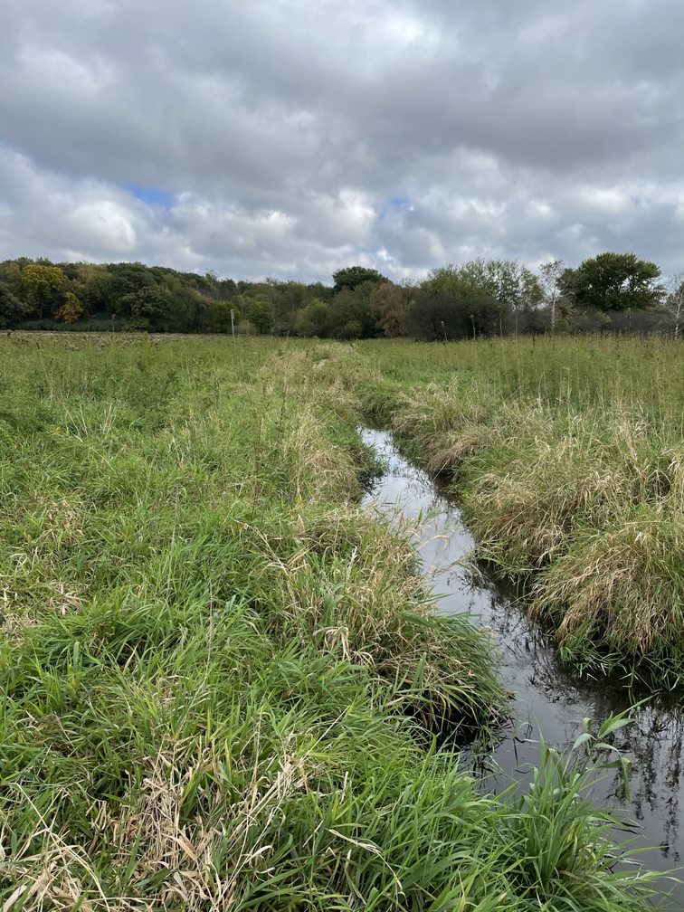
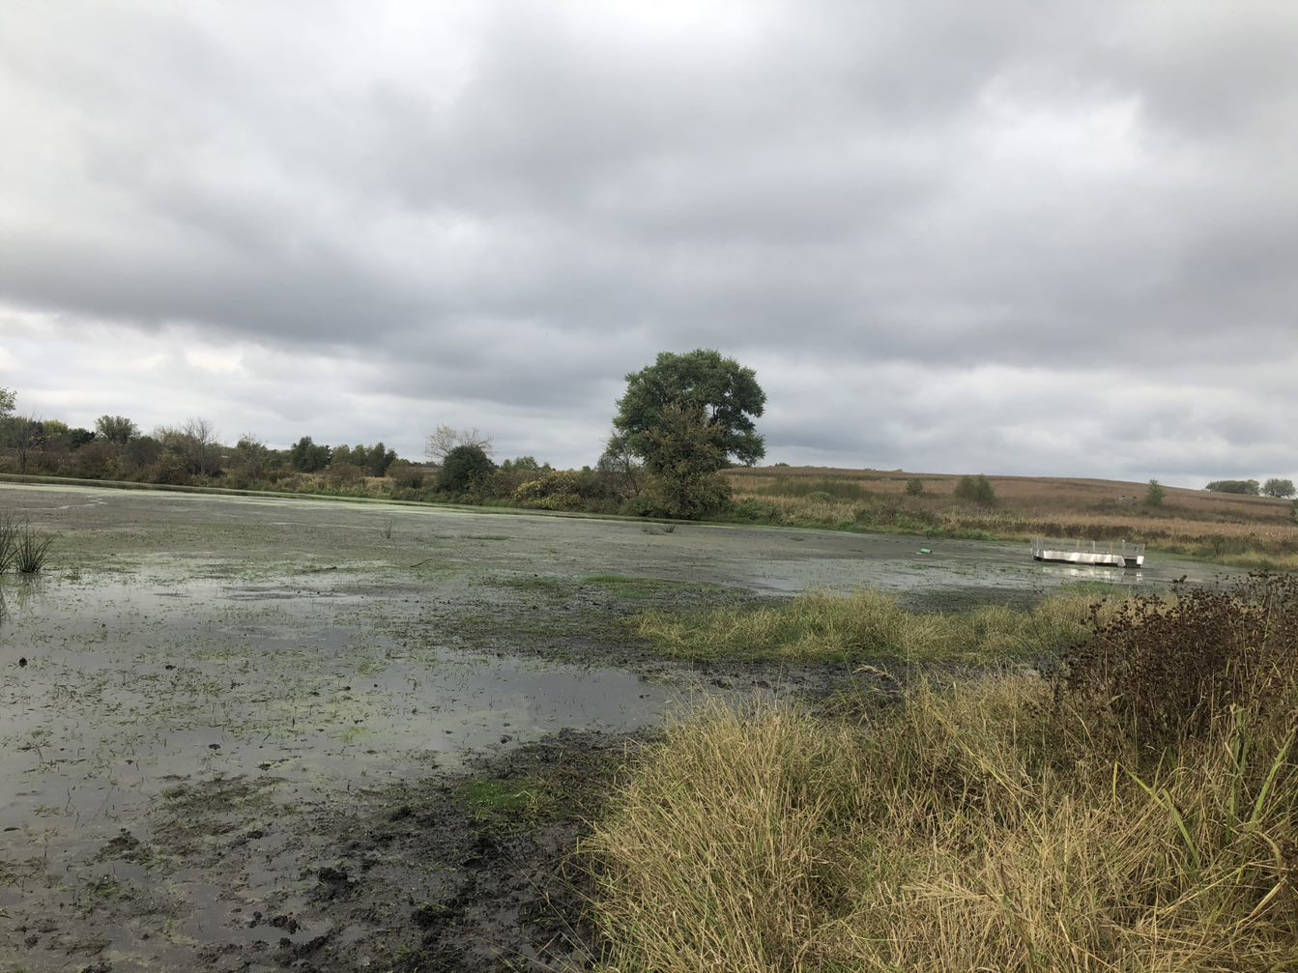
Project Background

Slide 5
Project Scope
Environmental Engineering:
Optimize Lake Water Quality
Removal of Nutrients from Tributary Stream
Geological Engineering:
Construction Phase Planned for Winter 2022 to Minimize Subsurface Impact
Hydrological Engineering:
Redirect Flow from Tributary into Preserve to Accomplish Environmental Goals
Increase Residence Time of Flow in Preserve
Surveying and Geospatial Engineering:
Manipulation of Existing Elevations to Minimize Required Excavation

Slide 6
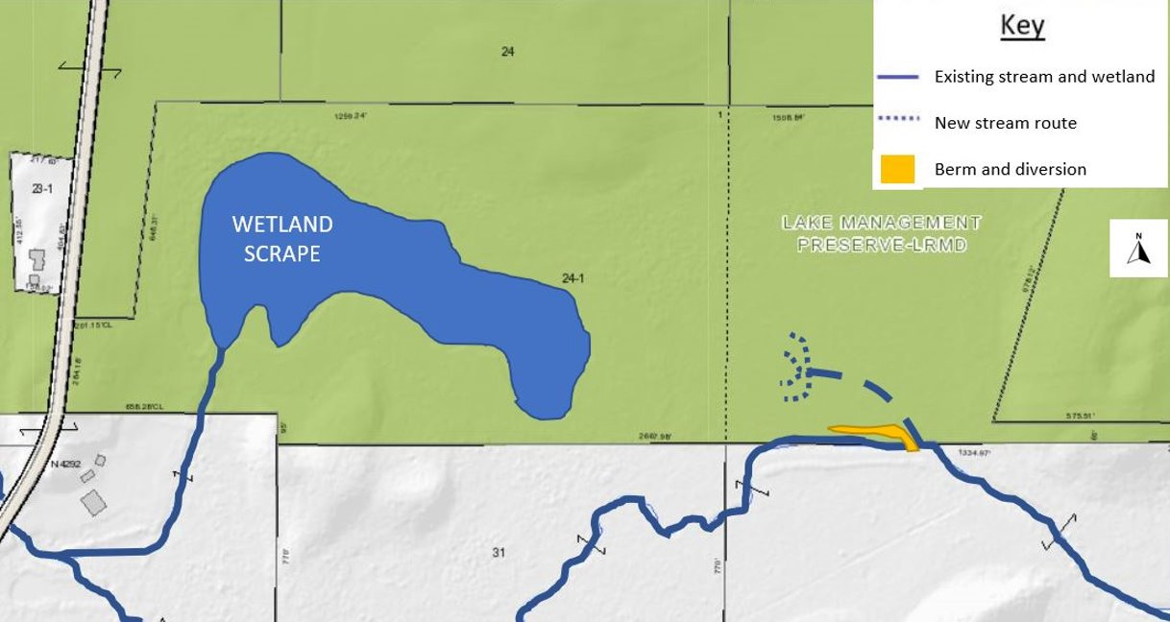
Proposed Alternative Summary
ALTERNATIVE 2 – BERM AND DIVERSION
Less control of flooding
Increased expense from additional seeding mixture and berm
Berm introduces a permanent tributary blockage

Slide 7
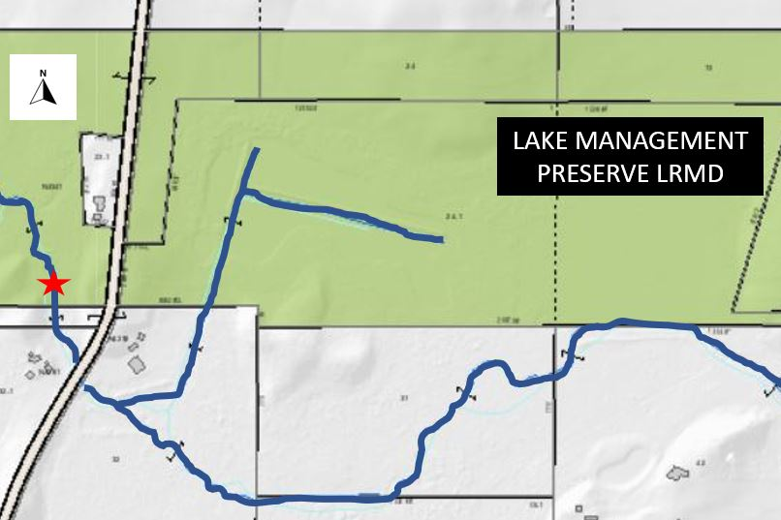
Proposed Alternative Summary
ALTERNATIVE 3 – WEIR INSTALLATION
Higher risk for flood impact to neighboring property owners
Highest probable construction cost
HWY A

Slide 8
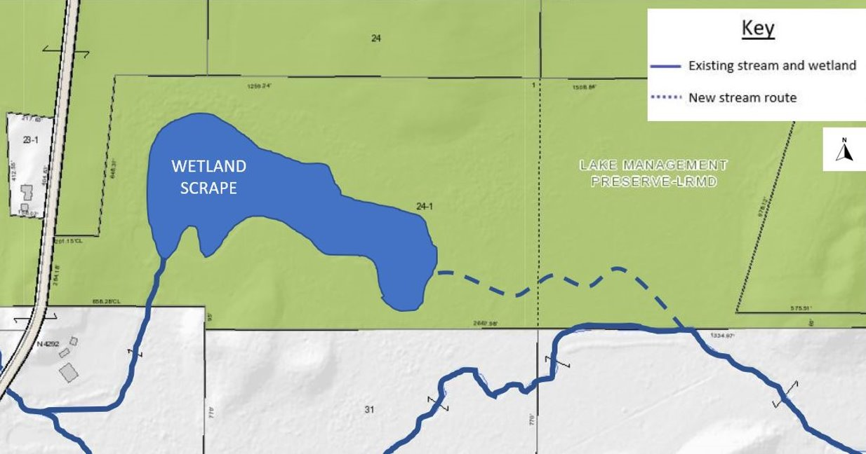
Recommended Alternative
ALTERNATIVE 1 – NEW CHANNEL EXCAVATION
Selected based on objective decision matrix and confirmed recommendation with client
More control of where flooding could occur
Accomplishes environmental project goals

Slide 9
Previous Questions & Comments
What is being done with sediment deposited in the wetland?
Nutrient removal modeling?
Are there streamflow modeling results available?
Further detail in time frame/cost of permitting phase?

Slide 10
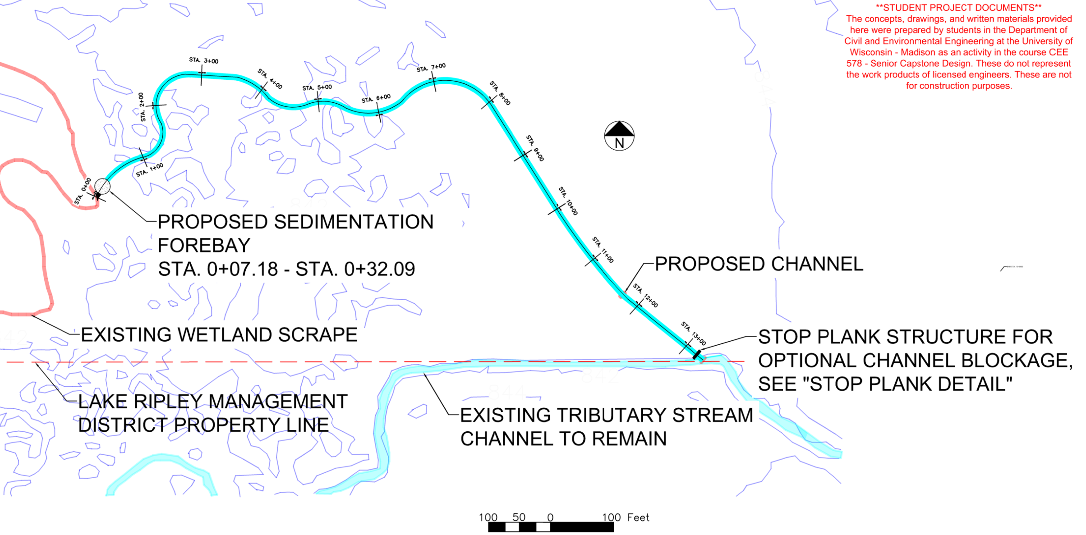
Alternative 1: Excavated Channel
Notes:
Thank you for the re-introduction to our project, Faith. Now I’m going to dive more into the specifics of our recommended alternative, Alternative 1. Here is an overview of the proposed route the stream would take to connect the existing tributary south of the Lake Ripley Management Preserve to the wetland scrape in the west of this picture

Slide 11
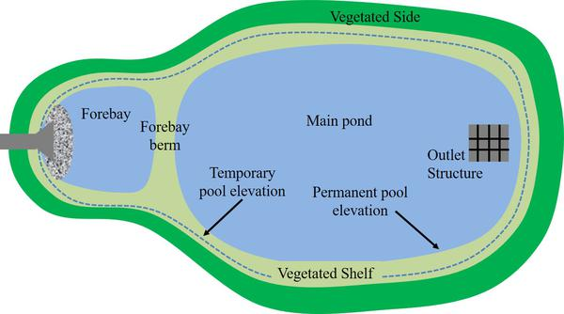
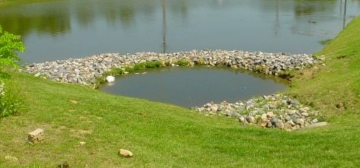
Forebay Detail
Vegetation
Existing Wetland Scrape
Channel
Porous Rock Berm
Vegetation
Notes:
Here you can see an increased view of the forebay I mentioned on the last slide. This forebay was recommended to us as a sedimentation basin by our mentors because the DNR would likely not want to have an influx of sediment into a wetland. Thus any suspended solid in the channel is able to settle out in the forebay before reaching the wetland scrape, while the porous rock berm allows the streamflow to continue on.

Slide 12
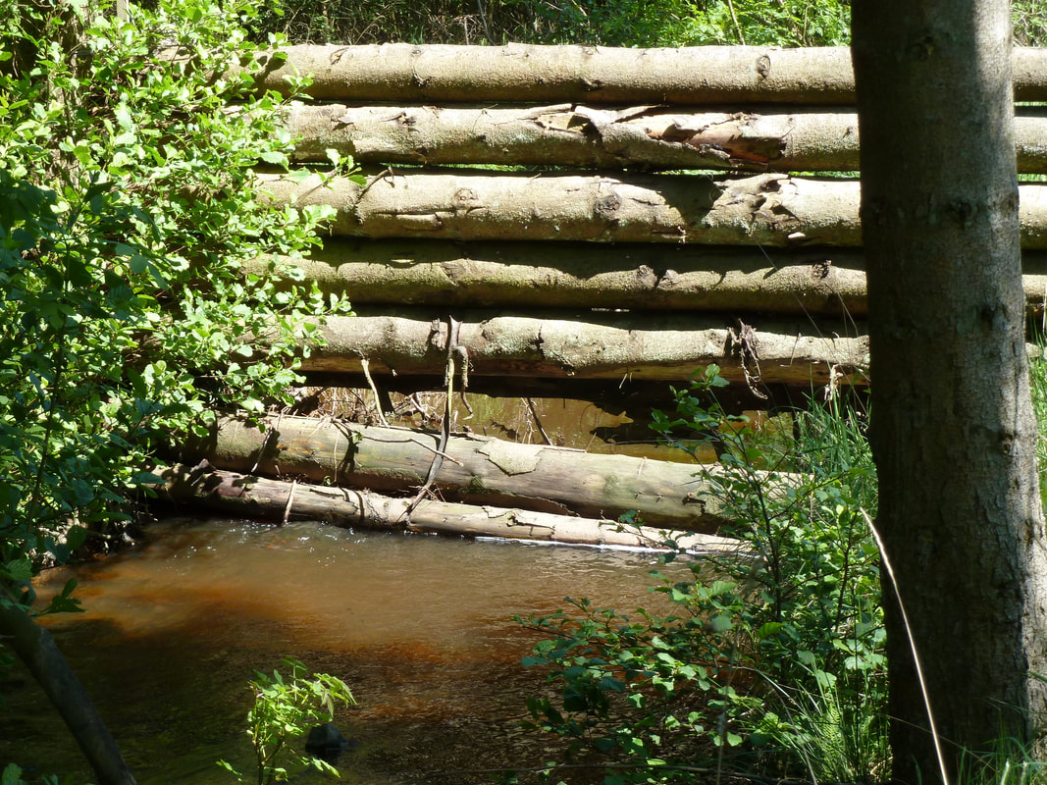
Stop Plank Detail
Concrete footings installed in streambanks
Option to install wood planks that slide into concrete footings to block off excavated channel
Notes:
This section and plan view highlights the stop plank that we are including at the start of the excavated channel in order to provide the LRMD with more control over the flow of the stream. This tool gives the LRMD the flexibility to stop flow into the excavated channel and return it to the existing tributary if needed. That way the infrastructure is there if needed.

Slide 13
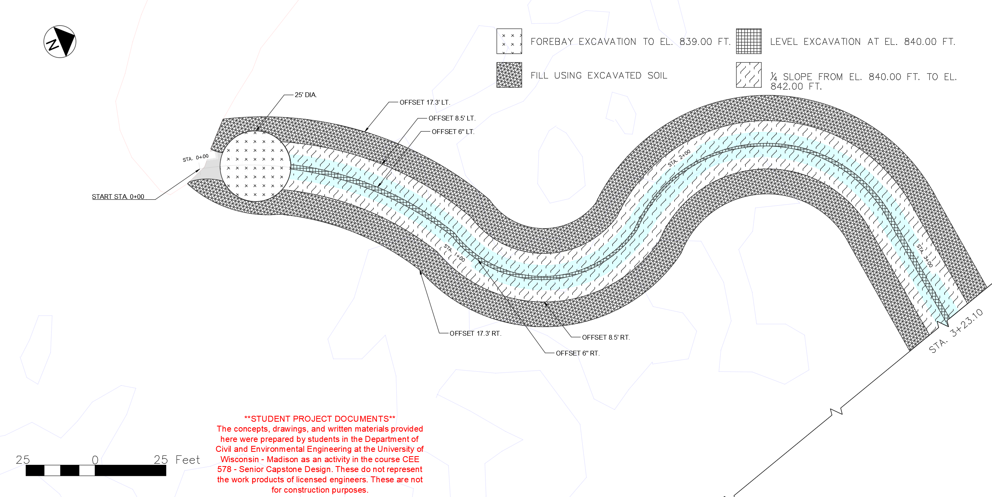
Grading Plan
FOREBAY EXCAVATION
LEVEL EXCAVATION AT 840’
FILL WITH EXCV. SOIL
¼ SLOPE STARTING AT 840’
Notes:
I want to review is the Grading Plan as shown here. This is the first section of our proposed channel starting from the existing wetland scrape on the left.
This first highlighted region, the center of the channel will be excavated to level at 840’ of elevation – the elevation of the wetland scrape. This is the base of our proposed channel. Since there is only a two foot elevation drop from the start of the channel to the wetland scrape, the bed slope will be constant.
The darker blue color indicates the slopes of the channel. One of the items that our client discussed with us was having shallow banks so that the channel could easily flood into the surrounding wetland in case of a high rain event. The 4 to 1 grade indicated in this region will allow the streamflow to be wide and shallow throughout the channel.
Next, this green region showcases where the soil that is removed during excavation will be placed in order to fortify the banks of the new channel.
Lastly, the navy blue section highlights the location of the proposed forebay sedimentation basin. The base elevation here is one foot lower than the existing wetland scrape in order to allow the sediment to settle out.
This image depicts approximately half of the excavated channel, the other half follows the same gradation patterns.
According to the DNR surface water data viewer there are delineated wetlands in this region. A delineation survey will be needed to certify where the location of wetlands are.

Slide 14
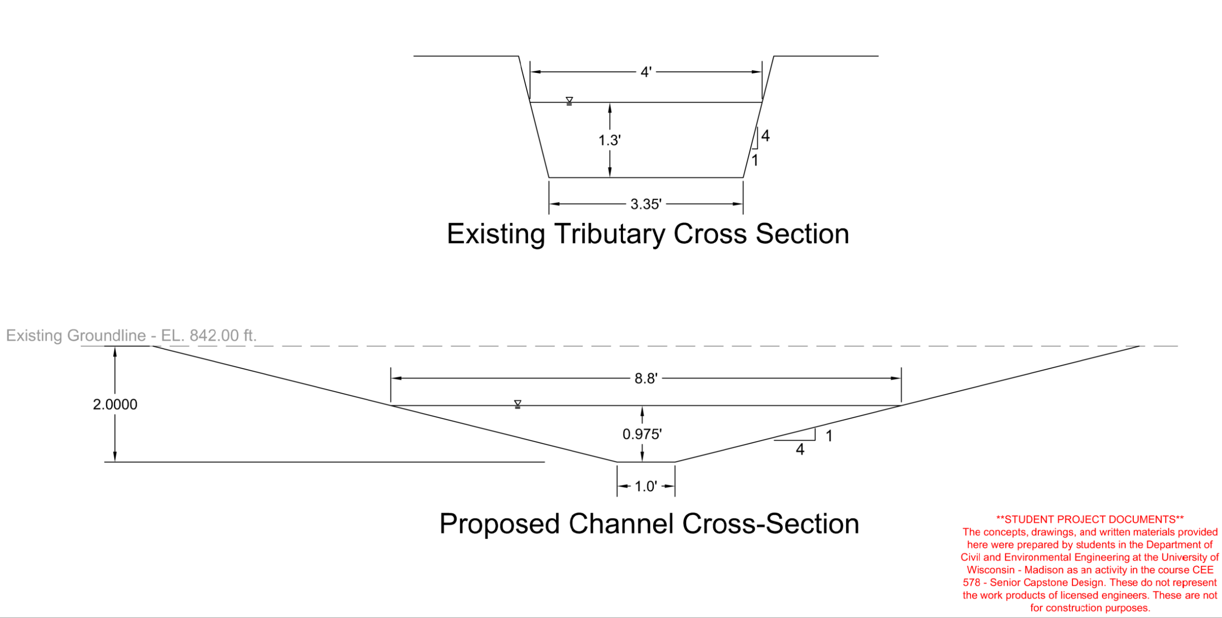
Existing and Proposed Cross Sections
Notes:
Here is a cross section that highlights the differences between the proposed excavated channel and the existing tributary. As you can see, the shallow nature of the channel paired with the gentle slopes of the banks allow for easier flooding – utilizing the surrounding wetland to help remove phosphorus and nitrogen from the stream.

Slide 15
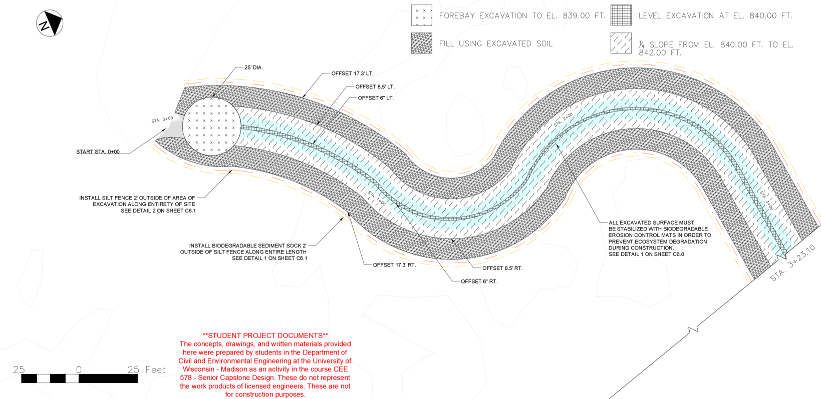
Erosion Control
FOREBAY EXCAVATION
LEVEL EXCAVATION AT 840’
FILL WITH EXCV. SOIL
¼ SLOPE STARTING AT 840’
SILT FENCE
EROSION CONTROL MATTING
SEDIMENT SOCK/BIOROLL
Notes:
This erosion control plan follows the layout of the grading plan in a couple ways. First, it is showing the same section of the proposed excavated channel.
The only major changes are the inclusion of a silt fence around the entirety of the excavation site in order to protect the surround ecosystem from sediment outflow.
secondly, A biodegradable sediment sock, or bioroll, should be installed outside of the silt fence in order to provide additional protection and stability to the surrounding environment.
lastly, it is noted that any excavated surface must be stabilized with biodegradeable erosion control mats during construction until the area can be more permanently stabilized through seeding.
Details for all of these erosion components are included in our construction drawings as industry standards.

Slide 16
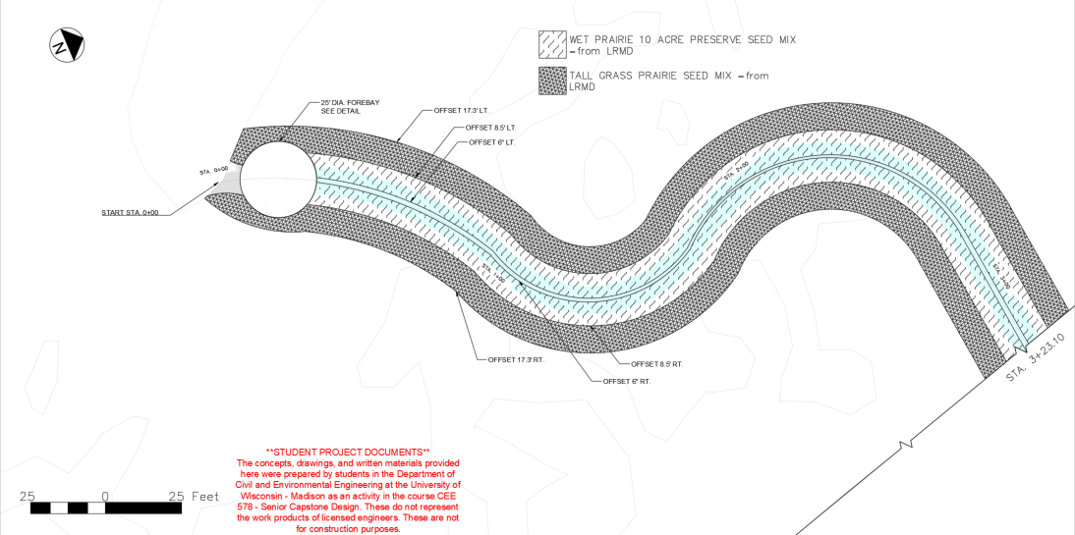
Seeding Plan
WET PRAIRIE SEED MIX
TALL GRASS SEED MIX
Notes:
We received a category of seed mixes from the LRMD, two separate types will be used to stabilize and rehabilitate the excavated area. A wet prairie seed mix will be used on the banks of the channel in order to prevent excess erosion from stripping the banks. Beyond where the streamflow will consistently be, a tall grass praire seed mix will be employed in order to stabilize the excavated fill around the stream and allow for more phosphorus and nitrogen absorption during flood events.

Slide 17
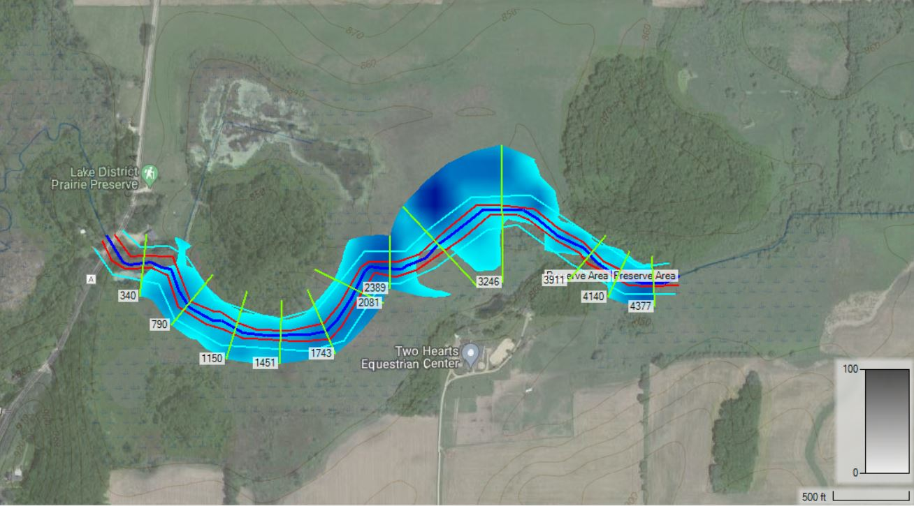
Hec Ras Modeling
Typical Flow = 0.68 cfs
Model Flow = 10 cfs

Slide 18
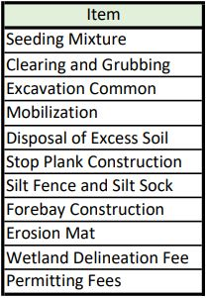
Opinion of Probable Cost
Project Budget: $2,000,000

Slide 19
Project Schedule
Permitting and Bidding
Dec 2021 – Nov 2022
Construction
Nov 2022 – Jun 2023
Substantial Completion
July 2023

Slide 20
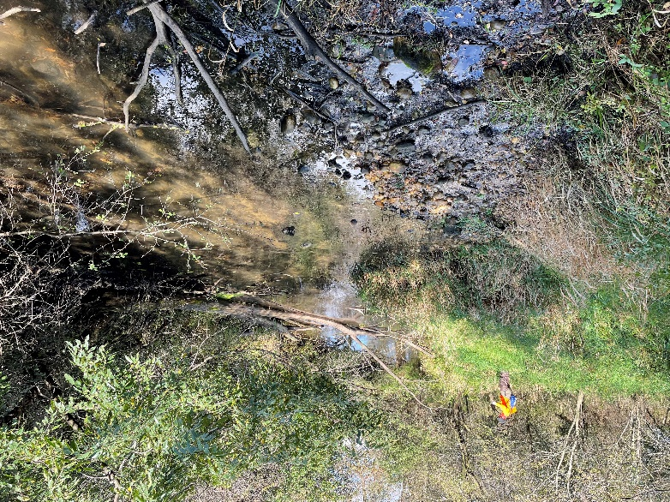
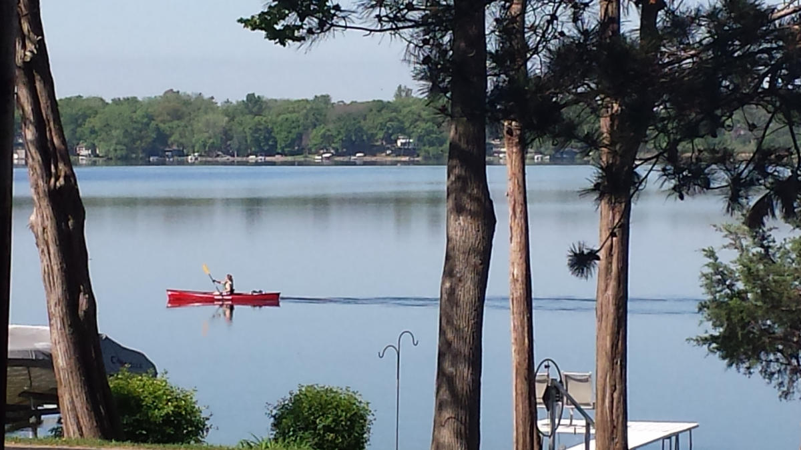
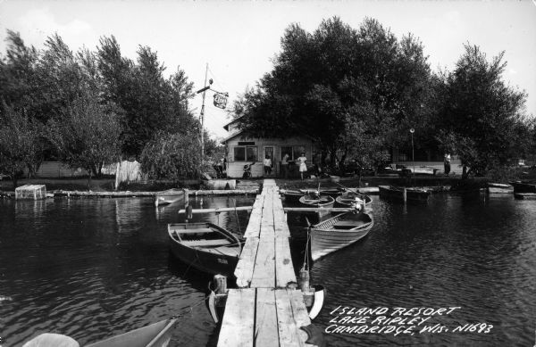
In Summary
LRMD Mission:
To preserve and enhance Lake Ripley’s water quality, its fish and wildlife communities, and its overall ecological health, while ensuring public access and use of the lake that is safe, fair and practical.

Slide 21
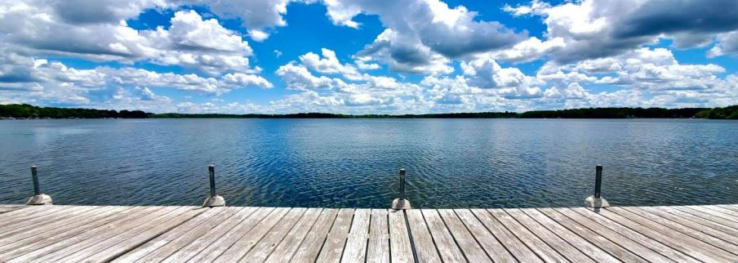
Thank You

